Slide 1
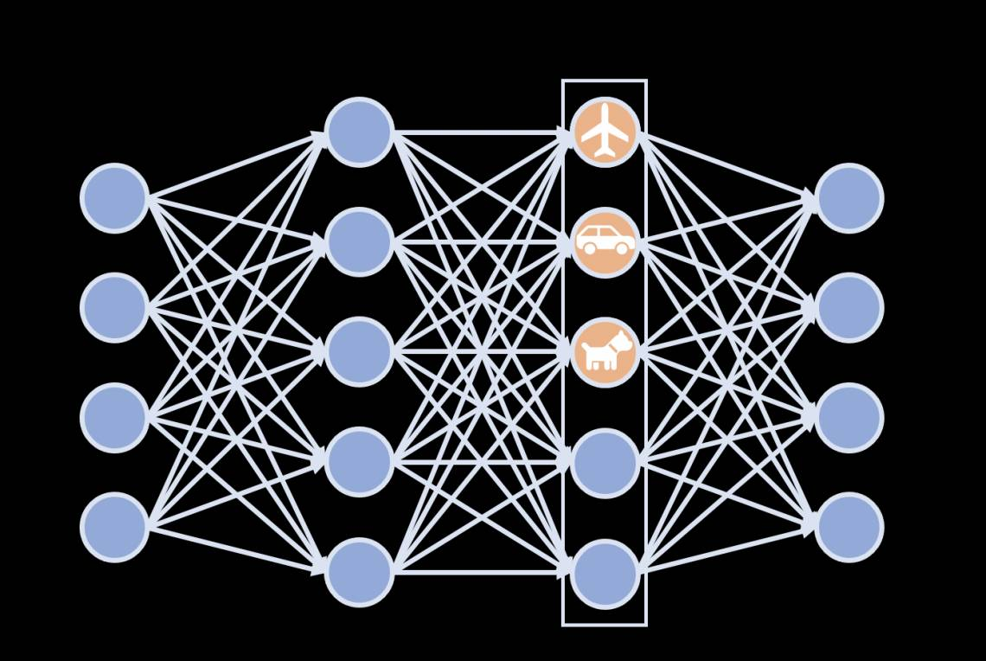
BEGINNER'S GUIDE
Supervised Learning
Classification Algorithms
A Comprehensive Guide to Logistic Regression, Decision Trees & SVM
with Practical Churn Prediction Implementation
Learn Three Core Algorithms
Build Real-World Models
Master Classification

Slide 2
Learning Journey
01
Understanding Classification
04
Support Vector Machines
Core concepts, binary vs. multiclass, real-world applications
Optimal boundaries, kernel trick, hyperparameter tuning
02
Logistic Regression
05
Churn Prediction Model
Sigmoid function, probability-based classification, strengths
Feature engineering, data preprocessing, training
03
Decision Trees
06
Evaluation & Deployment
Human-like decisions, Gini index, overfitting control
Metrics, model comparison, threshold optimization

Slide 3
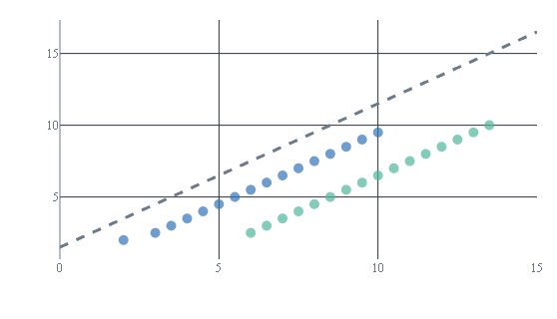
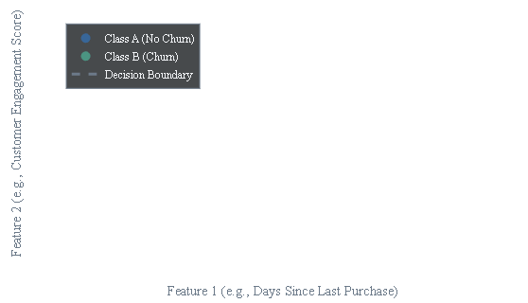

FOUNDATIONS
What is Classification in Machine Learning?
Core Concept
Decision Boundary Visualization
Classification is a supervised learning task that predicts discrete categories sor classes. The algorithm learns patterns from labeled training data and assigns new data points to predefined categories.
Key Principle:
Unlike regression that predicts continuous values, classification outputs specific categories like "Yes/No" or "Spam/Ham"
Types of Classification
2
Binary Classification
Two possible outcomes: Churn/No Churn, Spam/Not Spam
3+
Multiclass Classification
Three or more categories: Basic/Premium/Enterprise
Email Spam Detection
Medical Diagnosis
Classifies emails as "Spam" or "Not Spam"
Predicts disease presence: "Positive" or "Negative"

Slide 4
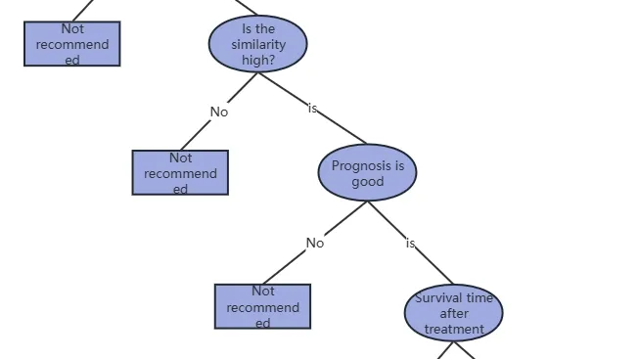
01
Logistic Regression
The Probability-Based Classifier
Despite its name, logistic regression is a powerful classification algorithm that uses probability to make decisions.
It transforms linear outputs into probabilities between 0 and 1, making it ideal for binary classification tasks like predicting customer churn, spam detection, and medical diagnosis.

Slide 5
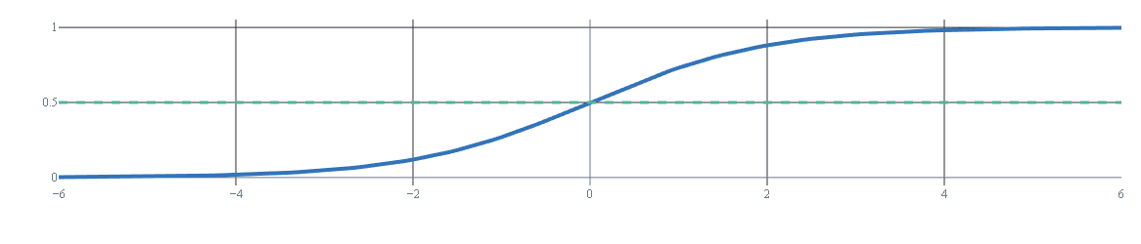
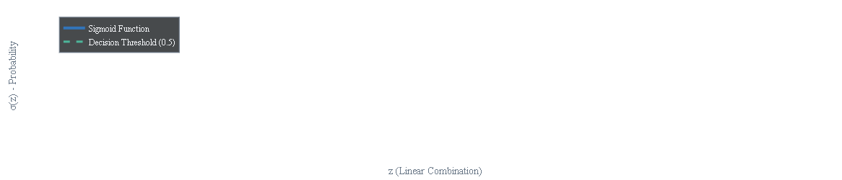

LOGISTIC REGRESSION
The Mathematics Behind the Magic
The Sigmoid Function
Decision Threshold
σ(z) = 1 / (1 + e-z)
After getting probability from sigmoid, we apply a threshold (typically 0.5 ) to make final classification:
Maps any real number to (0,1)
If σ(z) ≥ 0.5: Predict Class 1 (e.g., "Will Churn")
The sigmoid function transforms continuous linear regression output into probabilities suitable for classification.
The sigmoid function transforms continuous linear regression output into suitable for classification.
If σ(z) < 0.5: Predict Class 0 (e.g., "Won't Churn")
Output represents probability of belonging to positive class
Sigmoid Function Visualization
Key Assumptions
Advantages
Common Use Cases
• Binary dependent variable
• Probabilistic output
• Customer churn prediction
• Independent observations
• Highly interpretable
• Medical diagnosis
• Linear relationship with log-odds
• Fast training/prediction
• Fraud detection

Slide 6
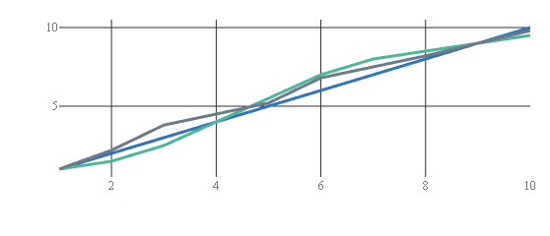
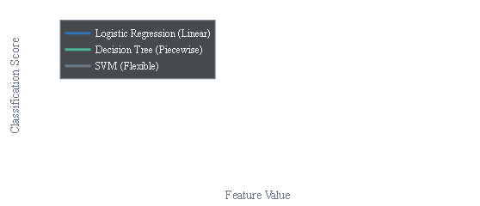

PRACTICAL GUIDANCE
Logistic Regression: When to Use & Key Strengths
Ideal Use Cases
Decision Boundaries Comparison
Interpretability is Crucial
When stakeholders need to understand WHY predictions are made, not just WHAT they are
Linearly Separable Data
When data shows clear linear patterns, logistic regression performs efficiently
Limited Resources
Fast training and prediction with minimal computational requirements
Practical Applications
Key Strengths
Fraud Detection
Medical Diagnosis
Probabilistic Outputs
Provides calibrated probabilities, not just hard classifications
Marketing Response
Customer Churn
Low Data Requirements
Performs well with small datasets (<100 samples)
Regularization Options
L1 (Lasso) and L2 (Ridge) prevent overfitting

Slide 7
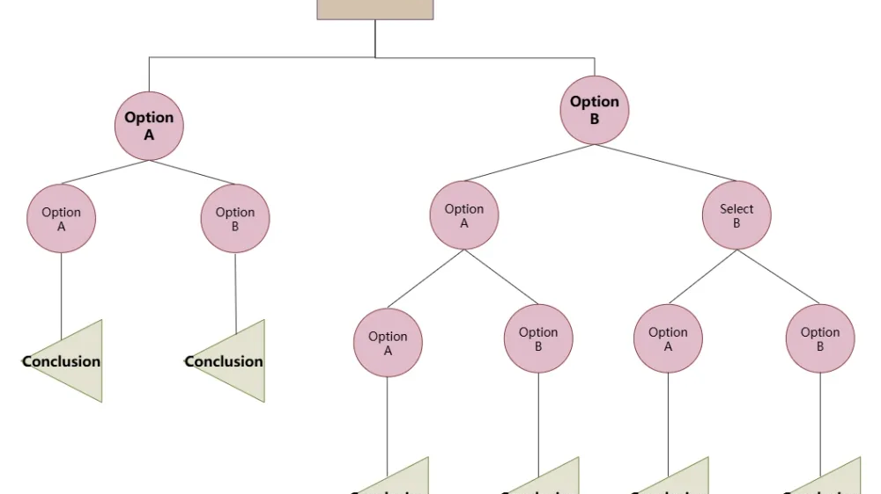
02
Decision Trees
The Human-Like Decision Maker
Decision trees mimic human decision-making by asking a series of yes/no questions to arrive at a conclusion.
They create intuitive, interpretable models that require minimal data preparation and can handle both numerical and categorical data with ease.

Slide 8
DECISION TREES
How They Think Like Humans
Tree Structure Components
Example: Play Tennis?
Root Node
Internal Nodes
Starting point with entire dataset
Decision points that split data
Branches
Leaf Nodes
Outlook = Sunny?
Outcomes of each decision
Final predictions (class labels)
No
Yes
Humidity > 70%?
Windy = True?
Splitting Criteria
No → Play
Yes → Don't
No → Play
Yes → Don't
Gini Index
Measures impurity of nodes. Lower Gini = purer splits.
Gini = 1 - Σ(pᵢ)²
Key Advantages
Information Gain
• Intuitive and easy to interpret
Measures information improvement. Higher gain = better split.
• Handles mixed data types (numerical + categorical)
IG = Entropy(parent) - Σ(Nᵢ/N) × Entropy(childᵢ)
• Minimal data preparation required
• Captures non-linear relationships

Slide 9
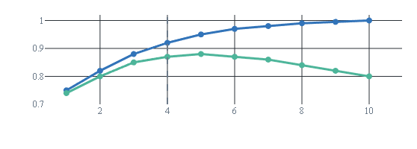
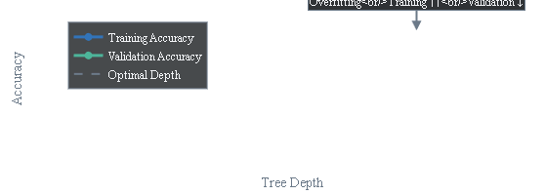

DECISION TREES
Strengths, Weaknesses & Optimization
Key Strengths
Overfitting Visualization
1
Handles Non-Linear Patterns
Captures complex interactions without feature transformation.
2
Highly Interpretable
Decision paths are transparent and business-friendly.
3
Minimal Data Prep
Handles both numerical and categorical data with ease.
4
Feature Selection Built-In
Automatically ignores irrelevant features during splits.
Challenges
Critical Hyperparameters
Overfitting Tendency
max_depth
Deep trees memorize training data, failing to generalize.
Limits depth to prevent overfitting. E.g., max_depth=5.
Instability
min_samples_split
Small data changes can create completely different trees.
Min samples to split a node. E.g., min_samples_split=20.
Bias Toward Features
min_samples_leaf
May favor features with more levels or missing values.
Min samples in a leaf node. E.g., min_samples_leaf=10.
ccp_alpha
Cost-complexity pruning. Removes nodes post-training.

Slide 10
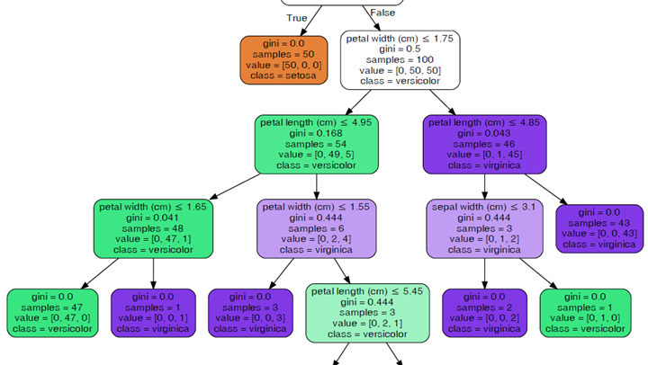
03
Support Vector Machines
The Boundary Finder
SVM finds the optimal boundary that maximizes the separation between different classes with the largest possible margin.
Using support vectors and the kernel trick, SVM can handle complex non-linear patterns that other algorithms struggle with.

Slide 11
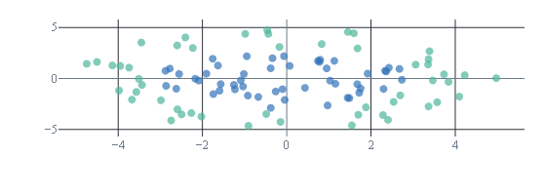
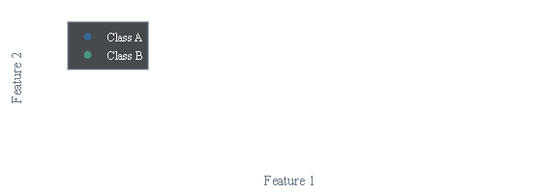
SUPPORT VECTOR MACHINES
Finding the Optimal Boundary
Core Concepts
Linear vs. Non-Linear SVM
Hyperplane
The decision boundary separating classes. Represented by wx + b = 0.
Support Vectors
Critical data points closest to the hyperplane that determine its position and orientation.
Margin
Distance between hyperplane and support vectors. SVM maximizes this margin.
The Kernel Trick
Optimization Goal
For non-linear data, SVM uses the kernel trick to transform data into higher dimensions where linear separation is possible.
SVM finds the hyperplane that maximizes the margin while minimizing classification errors.
Linear Kernel
RBF Kernel
Polynomial
Straight line separation
Complex non-linear patterns
Curved decision boundaries
Why Maximize Margin?
Larger margins improve generalization to unseen data, reducing overfitting.
Advantages
Limitations
• Effective in high-dimensional spaces
• Computationally expensive
• Versatile kernel functions
• Difficult to interpret
• Robust to outliers
• Sensitive to hyperparameters

Slide 12
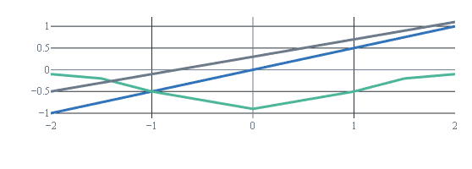
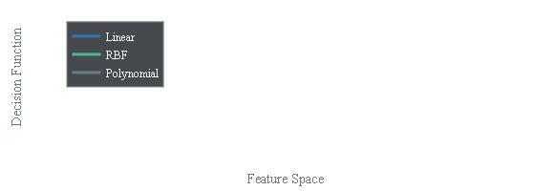
SUPPORT VECTOR MACHINES
Hyperparameters, Kernels & When to Choose
Critical Hyperparameters
Kernel Types Comparison
C (Regularization Parameter)
Linear Kernel
Balances margin maximization and misclassification penalty.
Best for: Large datasets, linearly separable data
High C
Low C
K(x,y) = x·y
Stricter penalty, smaller margin
More tolerance, larger margin
RBF Kernel (Default)
Best for: Non-linear patterns, general-purpose use
Gamma (γ)
K(x,y) = exp(-γ||x-y||²)
Defines influence of single training examples for RBF kernel.
High Gamma
Low Gamma
Polynomial Kernel
Tries to fit every example
Generalized decision boundary
Best for: Specific curved patterns, controlled complexity
K(x,y) = (x·y + c)ᵈ
Kernel Decision Boundaries

Slide 13
04
Practical Implementation
Building a Customer Churn Prediction Model
Now let's apply our knowledge to build a real-world churn prediction model using all three algorithms.
We'll cover the complete workflow: feature engineering, data preprocessing, model training, evaluation, and deployment strategies.

Slide 14
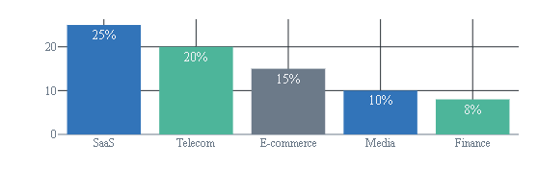

CHURN PREDICTION
Understanding the Business Problem
What is Customer Churn?
Typical Churn Rates by Industry
Customer churn occurs when customers stop using a company's products or services . This includes subscription cancellations, account closures, or prolonged inactivity.
Business Impact:
Acquiring new customers costs 5x more than retaining existing ones.
Common Churn Indicators
ML Approach to Churn
Reduced Engagement
Support Complaints
Instead of reacting after customers leave, we predict churn probability to enable proactive retention.
Less usage
More tickets
Subscription Cancellations
Decreased Transactions
Project Workflow:
Turning off auto-renew
Lower purchase frequency
1
2
3
4
5
Data
Features
Training
Evaluation
Deploy

Slide 15
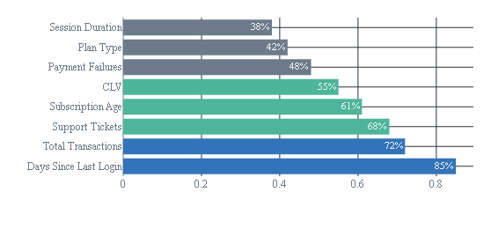
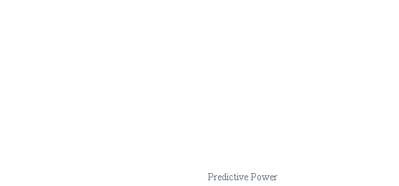

FEATURE ENGINEERING
Feature Engineering: The Secret Sauce
What is Feature Engineering?
Feature Importance in Churn Prediction
The process of creating predictive variables from raw data. It's the most creative and impactful part of machine learning.
Why It Matters:
Good features can outperform complex algorithms. "Garbage in, garbage out."
Key Feature Categories for Churn
RFM Analysis
Recency, Frequency, Monetary value
Feature Engineering Tips
Time-Based Features
Subscription duration, trends
Create lag features: Compare recent vs. historical behavior
Use domain knowledge: Consult business experts
Engagement Metrics
Handle outliers: Cap extreme values to prevent dominance
Login frequency, feature usage

Slide 16
DATA PREPROCESSING
Data Preprocessing Pipeline
Essential Preprocessing Steps
1
Data Collection
2
Missing Values
3
Categorical Encoding
Gather customer demographics, transactions, and interactions.
Impute numerical (median) and categorical (mode) data.
Use one-hot encoding for plan types and payment methods.
4
Feature Scaling
5
Train-Test Split
6
Handle Imbalance
Apply normalization for SVM and logistic regression.
Use temporal split (train on past, test on future).
Use SMOTE or class weights for balanced datasets.
Preprocessing Code
Sample Data Structure
# Example preprocessing pipelinefrom sklearn.model_selection import train_test_split
from sklearn.preprocessing import StandardScaler
from imblearn.over_sampling import SMOTE
# Temporal split
X_train, X_test, y_train, y_test = train_test_split(
X, y, test_size=0.2, shuffle=False)
# Feature scaling
scaler = StandardScaler()
X_train_scaled = scaler.fit_transform(X_train)
X_test_scaled = scaler.transform(X_test)
# Handle imbalance
smote = SMOTE(random_state=42)
X_balanced, y_balanced = smote.fit_resample(X_train_scaled, y_train)
CustomerID | Recency | Frequency | Churn
1001 | 5 | 25 | 0
1002 | 45 | 3 | 1
1003 | 12 | 18 | 0
Churn = 1 (Yes), 0 (No)

Slide 17
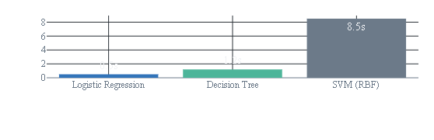
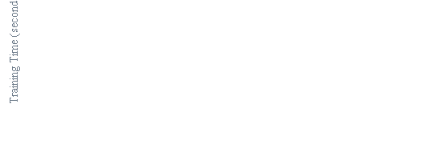

MODEL TRAINING
Training Three Models: Code Implementation
1. Logistic Regression
2. Decision Tree
from sklearn.linear_model import LogisticRegression
from sklearn.metrics import classification_report
# Initialize model
lr_model = LogisticRegression(
random_state=42,
max_iter=1000,
class_weight='balanced')
# Train and predict
lr_model.fit(X_train_scaled, y_train)
lr_pred = lr_model.predict(X_test_scaled)
lr_prob = lr_model.predict_proba(X_test_scaled)[:, 1]
from sklearn.tree import DecisionTreeClassifier
# Initialize model with pruning
dt_model = DecisionTreeClassifier(
max_depth=5,
min_samples_split=20,
min_samples_leaf=10,
random_state=42,
class_weight='balanced')
# Train and predict
dt_model.fit(X_train_scaled, y_train)
dt_pred = dt_model.predict(X_test_scaled)
dt_prob = dt_model.predict_proba(X_test_scaled)[:, 1]
Best for: Interpretability, baseline model, linear patterns
Best for: Interpretability, non-linear patterns, mixed data types
3. Support Vector Machine
Training Time Comparison
from sklearn.svm import SVC
# Initialize model with RBF kernel
svm_model = SVC(
kernel='rbf',
C=1.0,
gamma='scale',
probability=True,
random_state=42,
class_weight='balanced')
# Train and predict
svm_model.fit(X_train_scaled, y_train)
svm_pred = svm_model.predict(X_test_scaled)
svm_prob = svm_model.predict_proba(X_test_scaled)[:, 1]
Best for: High accuracy, non-linear patterns, high-dimensional data

Slide 18
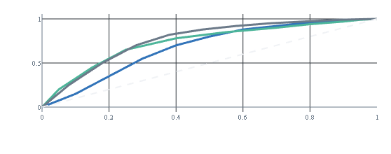
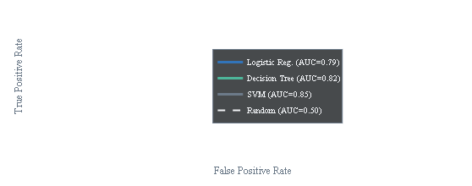

MODEL EVALUATION
Model Evaluation: Understanding the Metrics
Confusion Matrix
ROC Curve Comparison
True Negative
False Positive
85
5
False Negative
True Positive
3
7
Actual vs. Predicted Classes (Example)
Key Metrics Formulas
Accuracy = (TP+TN)/(TP+TN+FP+FN)
Metric Guidelines
• Accuracy: Good for balanced datasets, misleading for imbalanced.
Precision = TP/(TP+FP)
• Precision: Important when false positives are costly.
• Recall: Critical when false negatives are costly.
Recall = TP/(TP+FN)
• ROC-AUC: Target 70-80% for good churn models.
F1 = 2×(Precision×Recall)/(Precision+Recall)

Slide 19
MODEL COMPARISON
Comparing Model Performance: Who Wins?
Performance Comparison Table
Metric | Logistic Regression | Decision Tree | SVM (RBF)
Accuracy | 82.5% | 85.2% | 87.1%
Precision | 78.3% | 81.7% | 84.5%
Recall | 74.8% | 79.2% | 82.3%
F1-Score | 76.5% | 80.4% | 83.4%
ROC-AUC | 0.79 | 0.82 | 0.85
Training Time | 0.5s | 1.2s | 8.5s
Prediction Speed | Very Fast | Fast | Medium
Interpretability | Excellent | Excellent | Poor
Best Overall Performance
Best Interpretability
Best Balance
SVM (RBF Kernel)
Logistic Regression & Decision Tree
Decision Tree
Highest accuracy, precision, recall, and AUC. Best for maximum predictive power.
Transparent models for business understanding and stakeholder communication.
Good performance with interpretability. Fast training and handles mixed data types well.

Slide 20
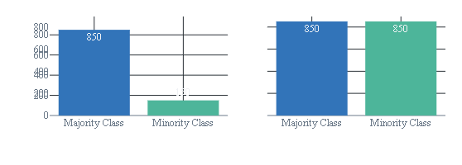
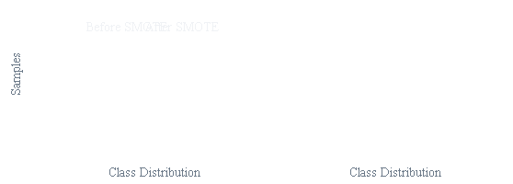
ADVANCED TECHNIQUES
Handling Class Imbalance: The SMOTE Technique
The Imbalance Problem
Before vs. After SMOTE
Churn datasets typically have 10-30% churn rate , causing models to favor the majority class and ignore churners.
Impact:
High accuracy but low recall—models predict "no churn" for everyone, missing the point.
SMOTE Solution
SMOTE creates synthetic minority class examples by interpolating between existing ones.
SMOTE Implementation
How It Works:
from imblearn.over_sampling import SMOTE
from sklearn.metrics import classification_report
# Apply SMOTE to training data
smote = SMOTE(random_state=42)
X_balanced, y_balanced = smote.fit_resample(X_train, y_train)
# Check new distribution
print(f"Original: {y_train.value_counts()}")
print(f"Balanced: {y_balanced.value_counts()}")
# Train model on balanced data
model.fit(X_balanced, y_balanced)
predictions = model.predict(X_test)
Identifies a minority class sample.
Finds its k nearest neighbors (k=5).
Creates synthetic points along the lines connecting it to its neighbors.

Slide 21
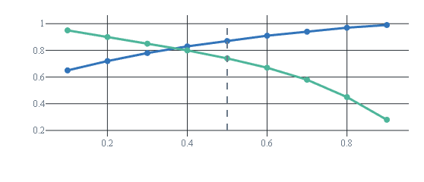
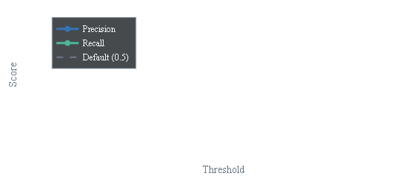
BUSINESS OPTIMIZATION
Threshold Optimization: Beyond the Default 0.5
Classification Threshold
Precision-Recall Tradeoff
Models output probabilities. The threshold determines when to predict the positive class (churn).
Default: 0.5
Predict churn if probability ≥ 50%
Custom: 0.2
Predict churn if probability ≥ 20% (higher recall)
Business-Driven Selection
Finding Optimal Threshold
Low Retention Cost
from sklearn.metrics import precision_recall_curve
# Get probability scores
y_scores = model.predict_proba(X_test)[:, 1]
# Calculate precision-recall for all thresholds
precision, recall, thresholds = precision_recall_curve(y_test, y_scores)
# Find threshold that maximizes F1
f1 = 2 * (precision * recall) / (precision + recall)
optimal_idx = np.argmax(f1)
optimal_threshold = thresholds[optimal_idx]
print(f"Optimal threshold: {optimal_threshold:.3f}")
Use lower threshold (e.g., 0.2) to catch more churners.
High Retention Cost
Use higher threshold (e.g., 0.7) to focus on high-confidence cases.

Slide 22
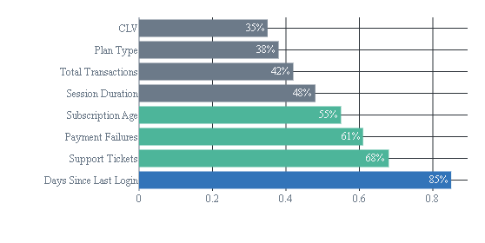


MODEL INTERPRETATION
Feature Importance: Understanding What Drives Churn
Why Feature Importance?
Top Churn Predictors
Understanding which variables most influence predictions provides actionable business insights.
Identify key churn drivers for business strategy
Improve feature engineering and selection
Build trust with business stakeholders
How to Extract Importance
Logistic Regression
Examine coefficient magnitude and direction
Decision Tree / Random Forest
Business Insights
Use `feature_importances_` from splits
• Recency: Most predictive. Recent activity decline is a red flag.
• Support Tickets: Unresolved issues drive churn. Improve support!
• Payment Methods: Certain methods indicate higher churn risk.

Slide 23
PRODUCTION DEPLOYMENT
Deployment Strategy: From Notebook to Production
Production Deployment Workflow
1
2
3
4
Save Model
Create Pipeline
Schedule Jobs
Monitor
Serialize with pickle/joblib
Preprocessing + model
Batch or real-time scoring
Track performance drift
Practical Deployment Steps
Model Maintenance
1
Schedule Predictions
Regular Retraining
Regular Retraining
Run daily/weekly to score all active customers.
Retrain monthly/quarterly with new data to maintain accuracy.
2
CRM Integration
Push high-risk customer lists to CRM for campaigns.
Performance Monitoring
Performance Monitoring
3
Set Up Alerts
Track AUC, precision, recall. Set up alerts for drops.
Trigger notifications for customers with >90% churn risk.
4
Track Effectiveness
Measure campaign impact on churn rates.
A/B Testing Strategy
A/B Testing Strategy
Test retention strategies: target high-risk customers vs. a control group.
Example: 1000 customers (90% risk). Control: 450, Treatment: 450. If treatment reduces churn to 80%, you retain 45 extra customers.
Example: 1000 customers (90% risk). Control: 450, Treatment: 450. If treatment reduces churn to 80%, you retain 45 extra customers.

Slide 24
CONGRATULATIONS!
Your Next Steps in
Machine Learning
You've learned three fundamental classification algorithms and built a practical churn prediction model. You now have the knowledge to tackle real-world classification problems.
Logistic Regression
Decision Trees
Support Vector Machines
For interpretability and linear problems
For human-like decisions and non-linear patterns
For complex boundaries and high accuracy
Continue Your Journey
Practice with Kaggle datasets
Learn neural networks for classification
Explore ensemble methods (Random Forest, XGBoost)
Study advanced feature engineering
The best way to learn is by doing. Start with simple models, understand your data, and iterate.

Slide 25
Important Links:
Notebook: Click Here

